Slide 1
SIRE516
Data visualization

Slide 2
Basic R plots

Slide 3
Basic R plots
Pro: Fast and simple
Con: More difficult customization
In this class, we will use these plots for quick visualization.
I will not cover customization of these plots.
Plot customizations will be done in ‘ggplot.’

Slide 4
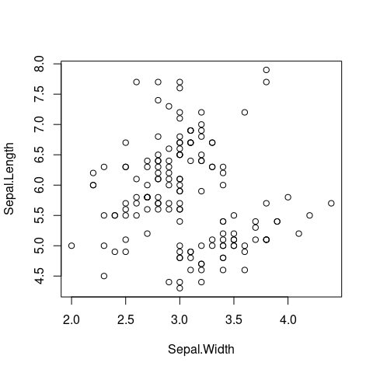

Scatter plot
Showing two dimensional data
Two numerical values

Slide 5
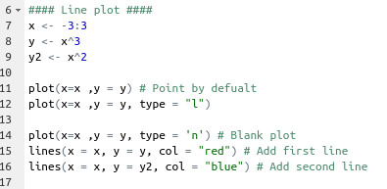
Line plot
Showing two dimensional data
Two numerical values
The line can show:
Repeated measurements over time (longitudinal data with X variable = time)
Trend of correlation between variables

Slide 6
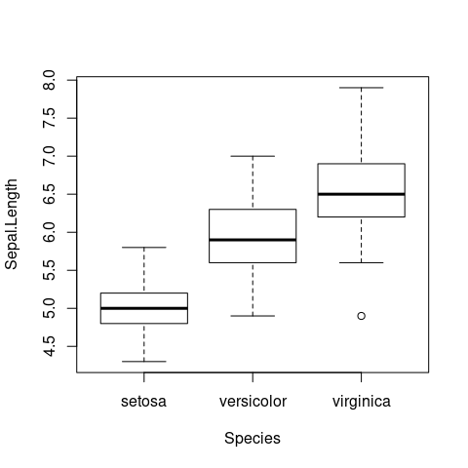

Box plot
Showing two dimensional data
One numerical value and one categorical value

Slide 7
Box plot
Interpretation
IQR = Q3-Q1
Q3 + 1.5 x IQR
Q3
Median (Q2)
Q1
Q1 – 1.5 x IQR
Outlier(s)

Slide 8
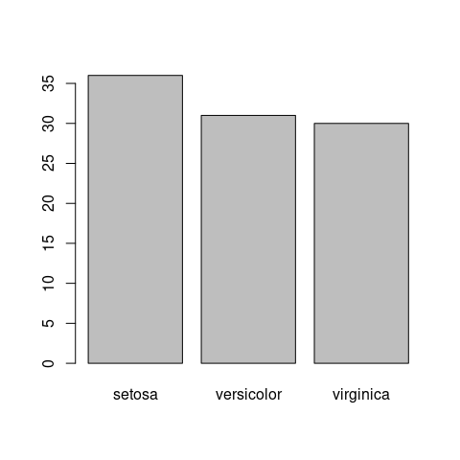
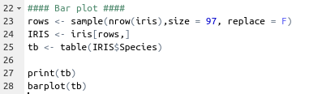
Bar plot
One-dimension data → Counts of categorical variables
Two-dimension data → One categorical and one central value (e.g. mean) of numerical variables
Mean + Standard error of the mean: If data are not normally distributed, the shape of distribution is lost.
Boxplot for showing how data are distributed

Slide 9
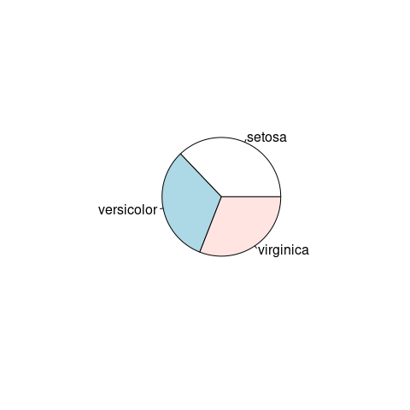
Pie chart
One-dimension data → Counts of categorical variables
Caution: Pie chart poorly presents data (angle vs height in bar plot). Avoid using it

Slide 10

How to save R plots
Specify where (what file format) you want to direct the plot from the screen/terminal to
Plot the plot
Turn off the direction

Slide 11
Practical 1

Slide 12

Practical 1
We will use basic R plots to explore ‘mtcars’ dataset
Try to select appropriate plot types

Slide 13
ggplot2

Slide 14
Why ggplot2?
Coding is more intuitive?
Customizations!
Plots with publication quality
Resolution
Format (fonts and special characters e.g. the Lancet’s decimal: 23·4, not 23.4)
Packages for advanced plots built from ggplot2
Survival analysis
Spatial statistics
Require some data preparations

Slide 15
Basic structure of ggplot2
graph <- ggplot(data = data1, aes(x = x1, y = y1, col = z1)) +
geom_point() +
geom_line(data = data2, aes_string(x = “x2”, y = “y2”, col = “z2))+
scale_color_discrete(…)+
scale_x_continuous(…)+
theme(panel.grid = …)
Plot elements are added step-by-step
Aesthetic mappings: aes (no “_”) and aes_string (with “_”) telling what plot element connect to what variable
Assign plot elements outside of aes() → Constant value (x = 1, col =“red”)

Slide 16
Basic structure of ggplot2
graph <- ggplot(data = data1, aes(x = x1, y = y1, col = z1)) +
geom_point() +
geom_line(data = data2, aes_string(x = “x2”, y = “y2”, col = “z2))+
scale_color_discrete(…)+
scale_x_continuous(…)+
theme(panel.grid = …)
geom_[plot type] → add data points to the plot as indicated by “plot_type”
scale_[something]_[data_type] → scale plot elements (usually) mapped by aes in a certain manner (e.g. log10-scale, customized color)
theme(…) → customize ‘static’ plot elements (e.g. fonts, grid)

Slide 17
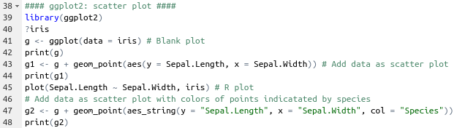
Scatter plot

Slide 18
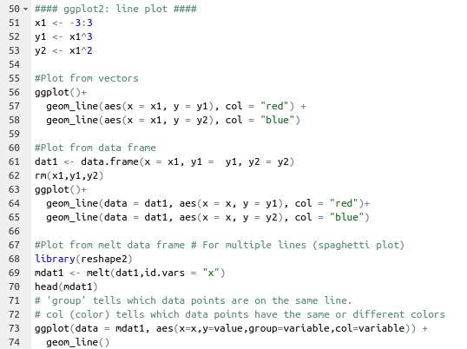
Line plot

Slide 19
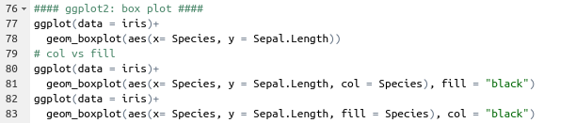
Box plot

Slide 20
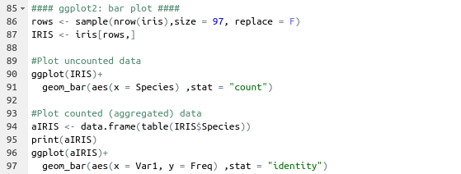
Bar plot
stat = “identity” can be used to plot “center” values of aggregated data (e.g. mean of group)

Slide 21
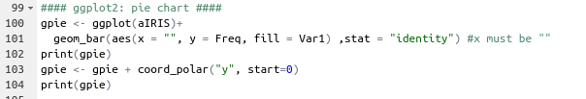
Pie chart
No pie chart function in ggplot2
Geom_bar(…)+ coord_polar(…)

Slide 22
How to save ggplot2
Simply use “ggsave()” function
Name the type of the picture you want to save (e.g. tiff, jpeg, png)
Specify dimension and units (e.g. width = 3, height = 4, unit = “in”)
Specify resolution (For publication dpi > 300)

Slide 23
Practical 2

Slide 24
Practical 2
As in practical 1, we will use ggplot2 to explore ‘mtcars’ dataset
Try to select appropriate plots plot types

Slide 25
ggplot2 customization

Slide 26
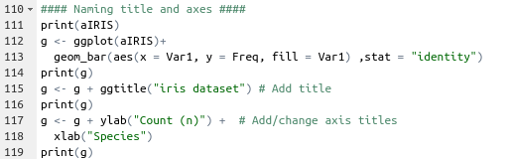
Naming title and axes

Slide 27
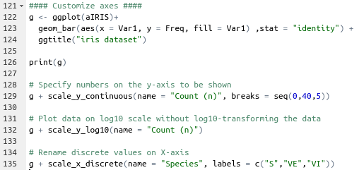
Customize axes

Slide 28
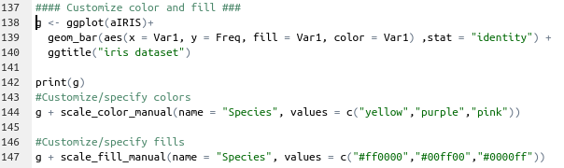
Customize color and fill

Slide 29
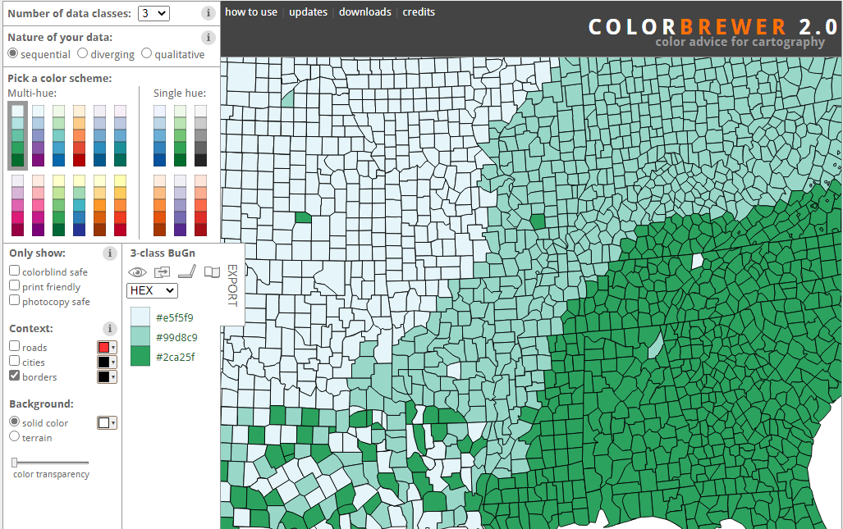
Color brewer
https://colorbrewer2.org/

Slide 30
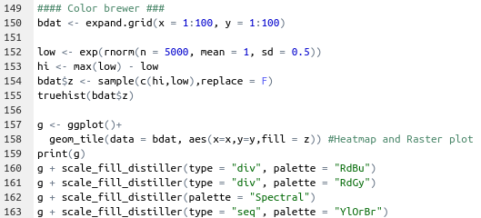
Color brewer

Slide 31
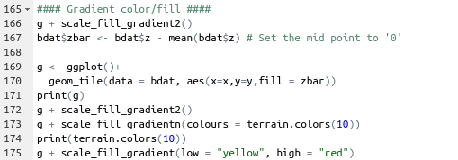
Gradient color/fill

Slide 32
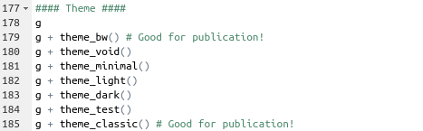
Theme!!!
Customize ‘static’ elements of the plot

Slide 33
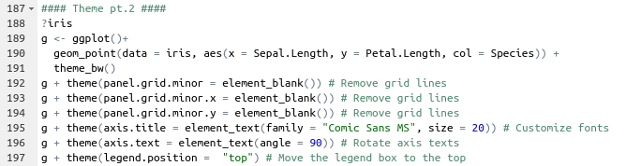
Theme!!!
Customize ‘static’ elements of the plot
There are so many “elements” in the theme so please refer to “https://ggplot2.tidyverse.org/reference/theme.html”

Slide 34
Add other elements to ggplot2

Slide 35
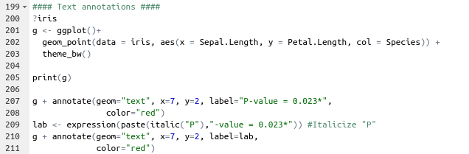
Text annotations

Slide 36
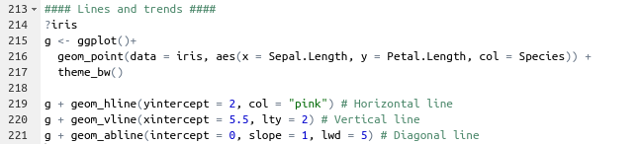
Lines and trends

Slide 37
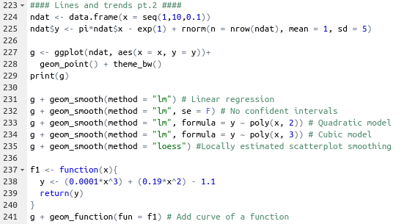
Lines and trends

Slide 38
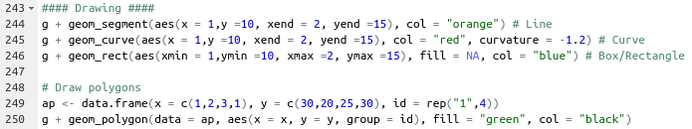
Drawing

Slide 39
Multiple plots

Slide 40
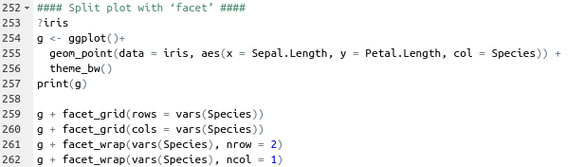
Split plot with ‘facet’

Slide 41
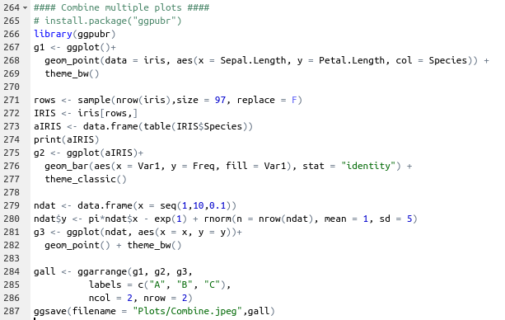
Combine multiple plots
ggarrange() in “ggpubr”

Slide 42
Resources
Cheat sheets: https://github.com/rstudio/cheatsheets/blob/main/data-visualization-2.1.pdf
Tutorial: http://r-statistics.co/Complete-Ggplot2-Tutorial-Part1-With-R-Code.html
ggpubr (improve ggplot2 for publication): http://www.sthda.com/english/articles/24-ggpubr-publication-ready-plots/

Slide 43
In-class assignment

Slide 44
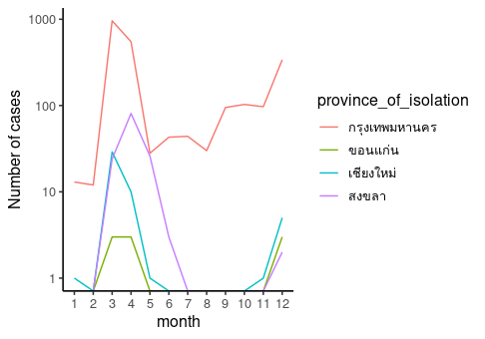
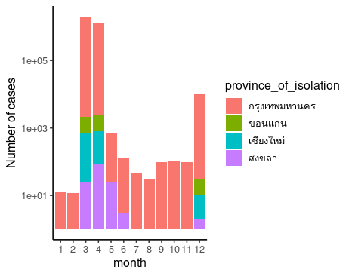
COVID-19 Data
Download COVID cases data from: https://data.go.th/dataset/8a956917-436d-4afd-a2d4-59e4dd8e906e/resource/be19a8ad-ab48-4081-b04a-8035b5b2b8d6/download/confirmed-cases.csv
Plot monthly cases from 1/1/2020 – 31/12/2020 (announce_date) showing data from Bangkok, Chiang Mai, Khon Kaen, Songkhla (province_of_isolation).
Plot either a line plot or a bar graph is OK (i.e., pick one).
Log10 scaling for the Y-axis is optional

